Slide 1

System Calls
Prof. Darrell Long
CSE 13S

Slide 2
What is a system call?
It’s like a function call, but handled by the operating system.
It does things for you that you cannot do:
File I/O
Communication
Synchronization
Process management
…
It is not part of the programming language.
It is invoked using wrapper functions that are part of a library.

Slide 3
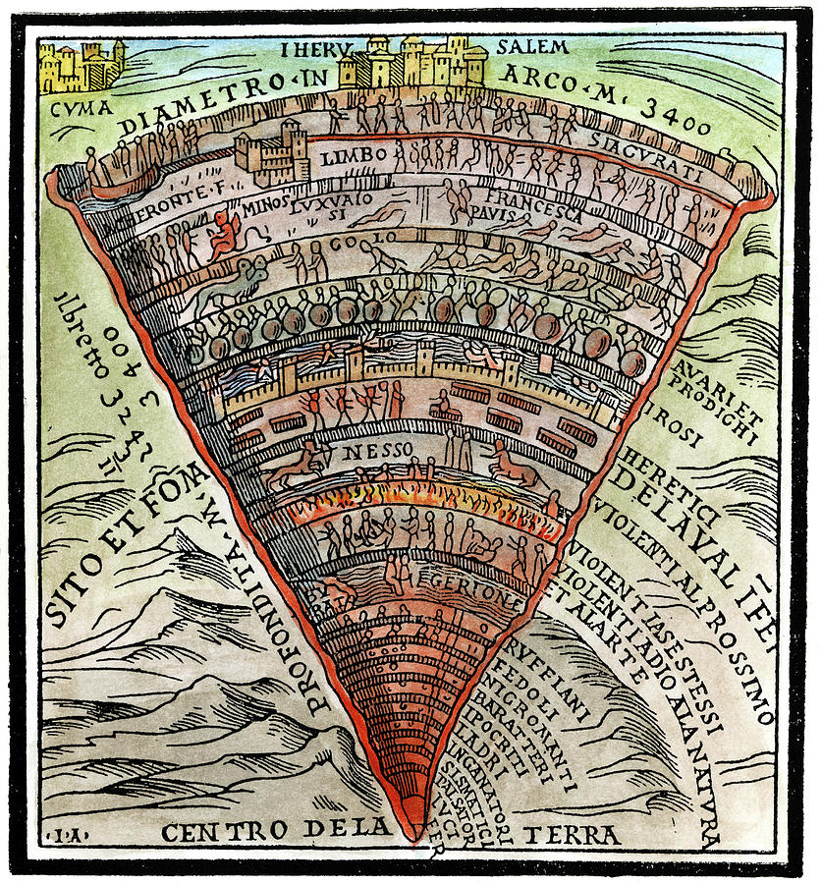
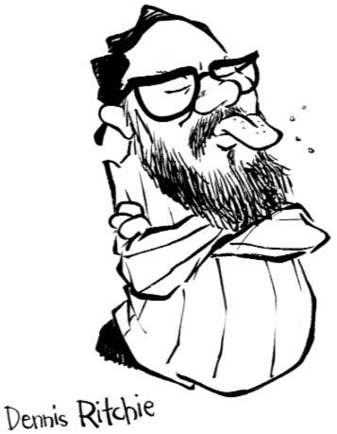
The Kernel may also be structured in levels
Hardware
Interrupts
Memory management
Processes
Device Drivers
File System
Other needful things…

Slide 4
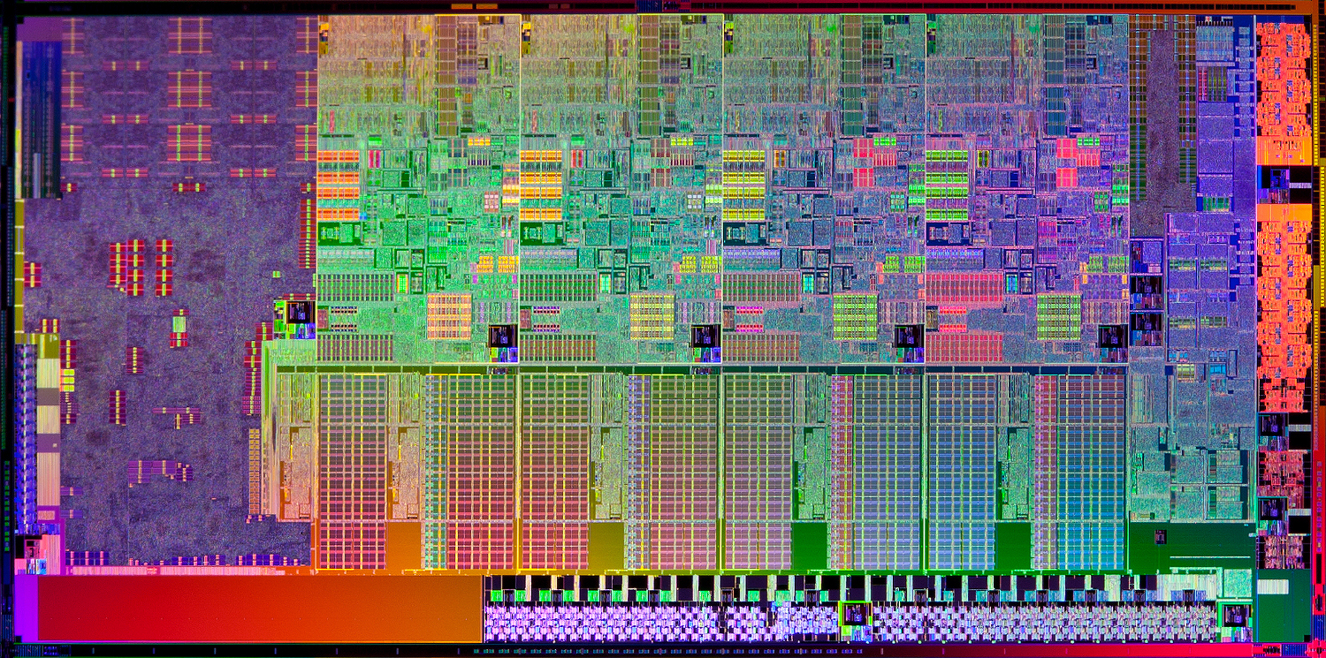
A Processor Die

Slide 5


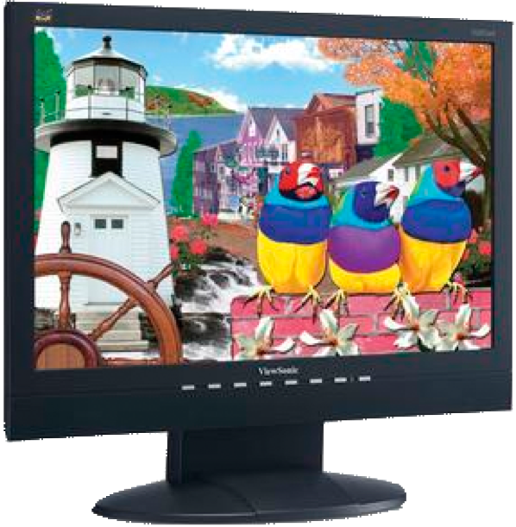
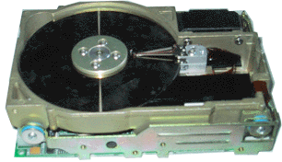
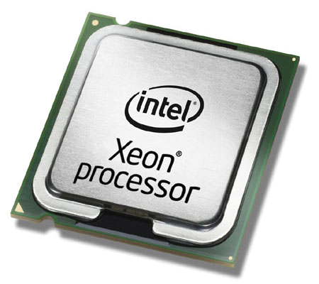
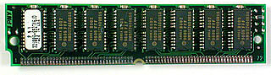
Computer Internals
Internet
Video controller
Hard drive controller
USB controller
Network controller
Computer internals (inside the “box”)
CPU
Memory

Slide 6

Operating System Structure
Device drivers
User code
The most privileged code runs at lower levels.
Some CPUs provide this functionality.
This diagram is conceptual.
Gate
Remember me?
File system
Core routines
(processes, memory management)

Slide 7

Monolithic Kernels
All of the OS is a single “program”
Any piece can access any other piece,
No fault isolation.
Sometimes modular extra pieces can be dynamically added (DLLs or kernel extensions):
These become part of the whole.
Easy to write, but hard to get right…
Main procedure
Service routines
Utility routines

Slide 8
Anatomy of a System Call
Kernel space (OS)
5
6
7
Dispatch
System
call handler
3
Trap code in register
Library (read)
4
Trap to kernel
8
Return to caller
User space
1
Push arguments
User code
2
Call read()
9
Increment stack pointer

Slide 9
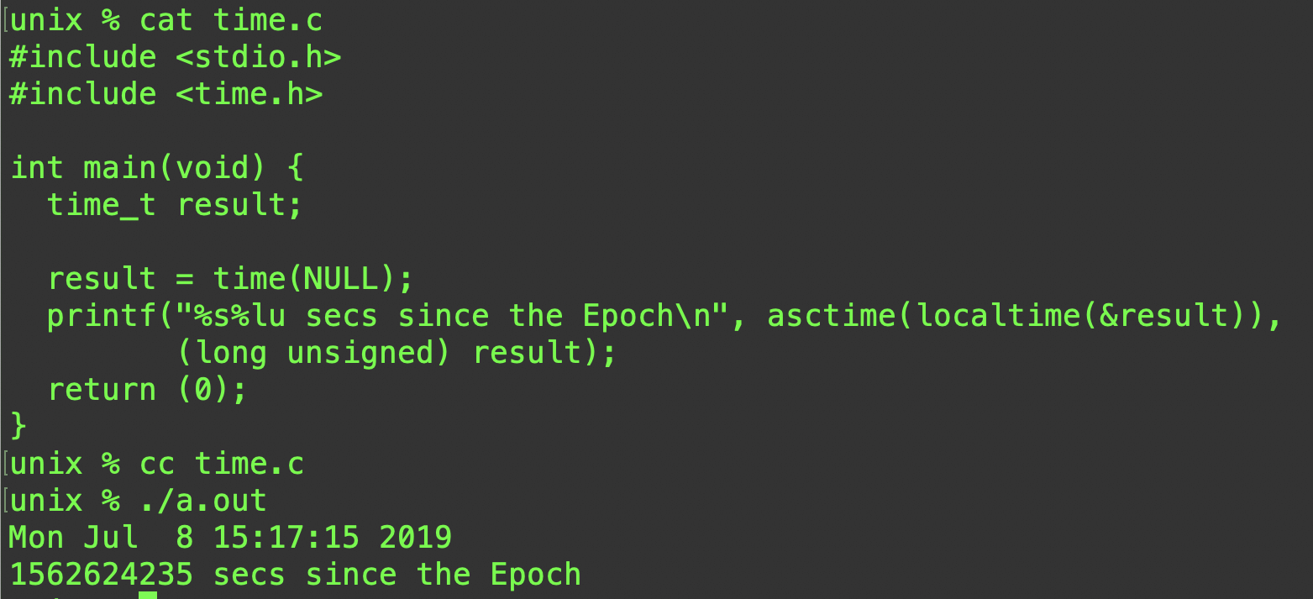
What time is it?
UNIX (Linux) measures time as second from the epoch (January 1, 1970).
time() is a system call.
localtime() and asctime() are library calls.
What is the difference?
A lot, and nothing. It depends on your point of view.

Slide 10
libc (the C library)
When we interact with the operating system we use libc.
libc provides both system calls and useful library routines.
Often you will neither know nor care about the difference.
Is it a system call or a library routine?
If you could write it yourself, it is probably a library routine, if you do not have the access or privilege to write it, it is probably a system call.
Library routines, like most of your programs, will make use of system calls (and other library routines).
f = open(“/tmp/HappyHappyJoyJoy”, O_RDWR, 0666)
Is a system call because you cannot write it.
x = sin(y)
Is a library routine because you can (and will) write it.

Slide 11
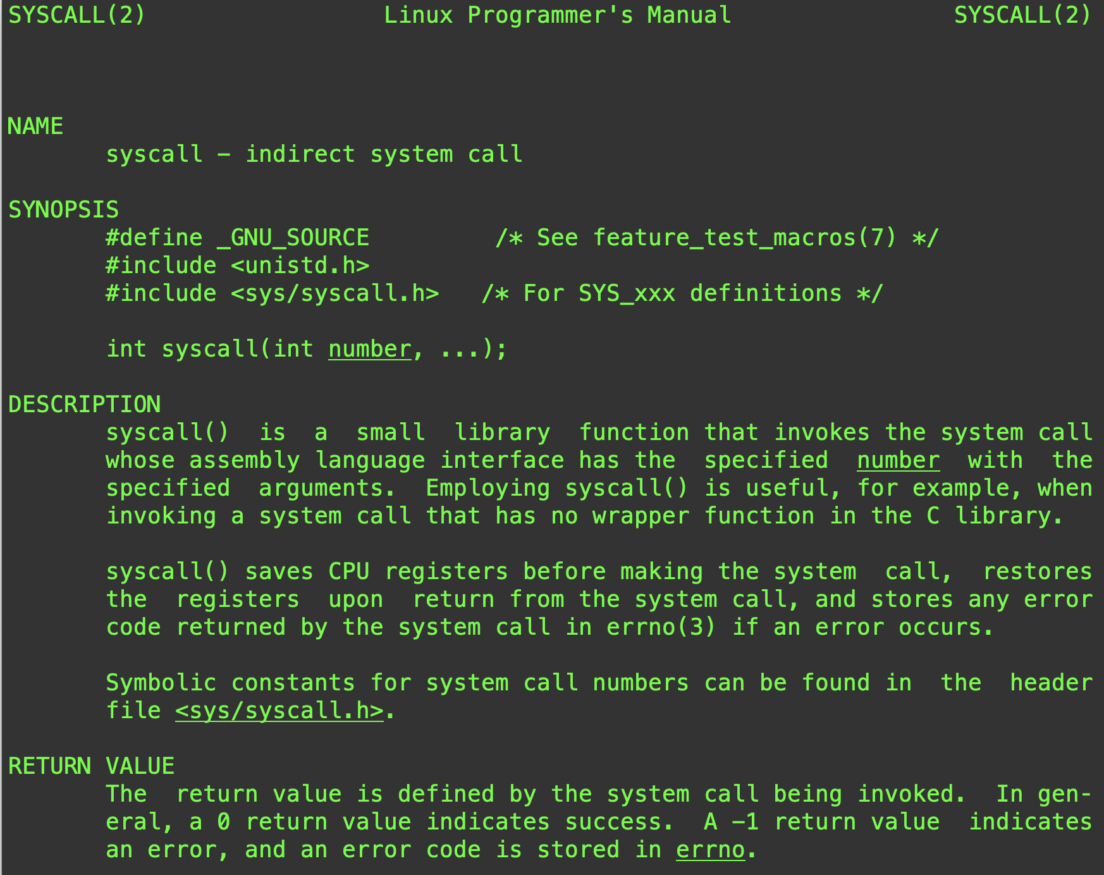

There’s really only one system call
Recall that a system call is a trap (gate) into the kernel.
It’s like an interrupt.
The function in the kernel to be called is looked up in a table by number.

Slide 12
File I/O
The core File I/O system calls are:
open(path, flags, mode)
close(file)
read(file, buffer address, length)
write(file, buffer address, length)
lseek(file, offset, whence)
There are others, but you can do most of what you need with these five.

Slide 13
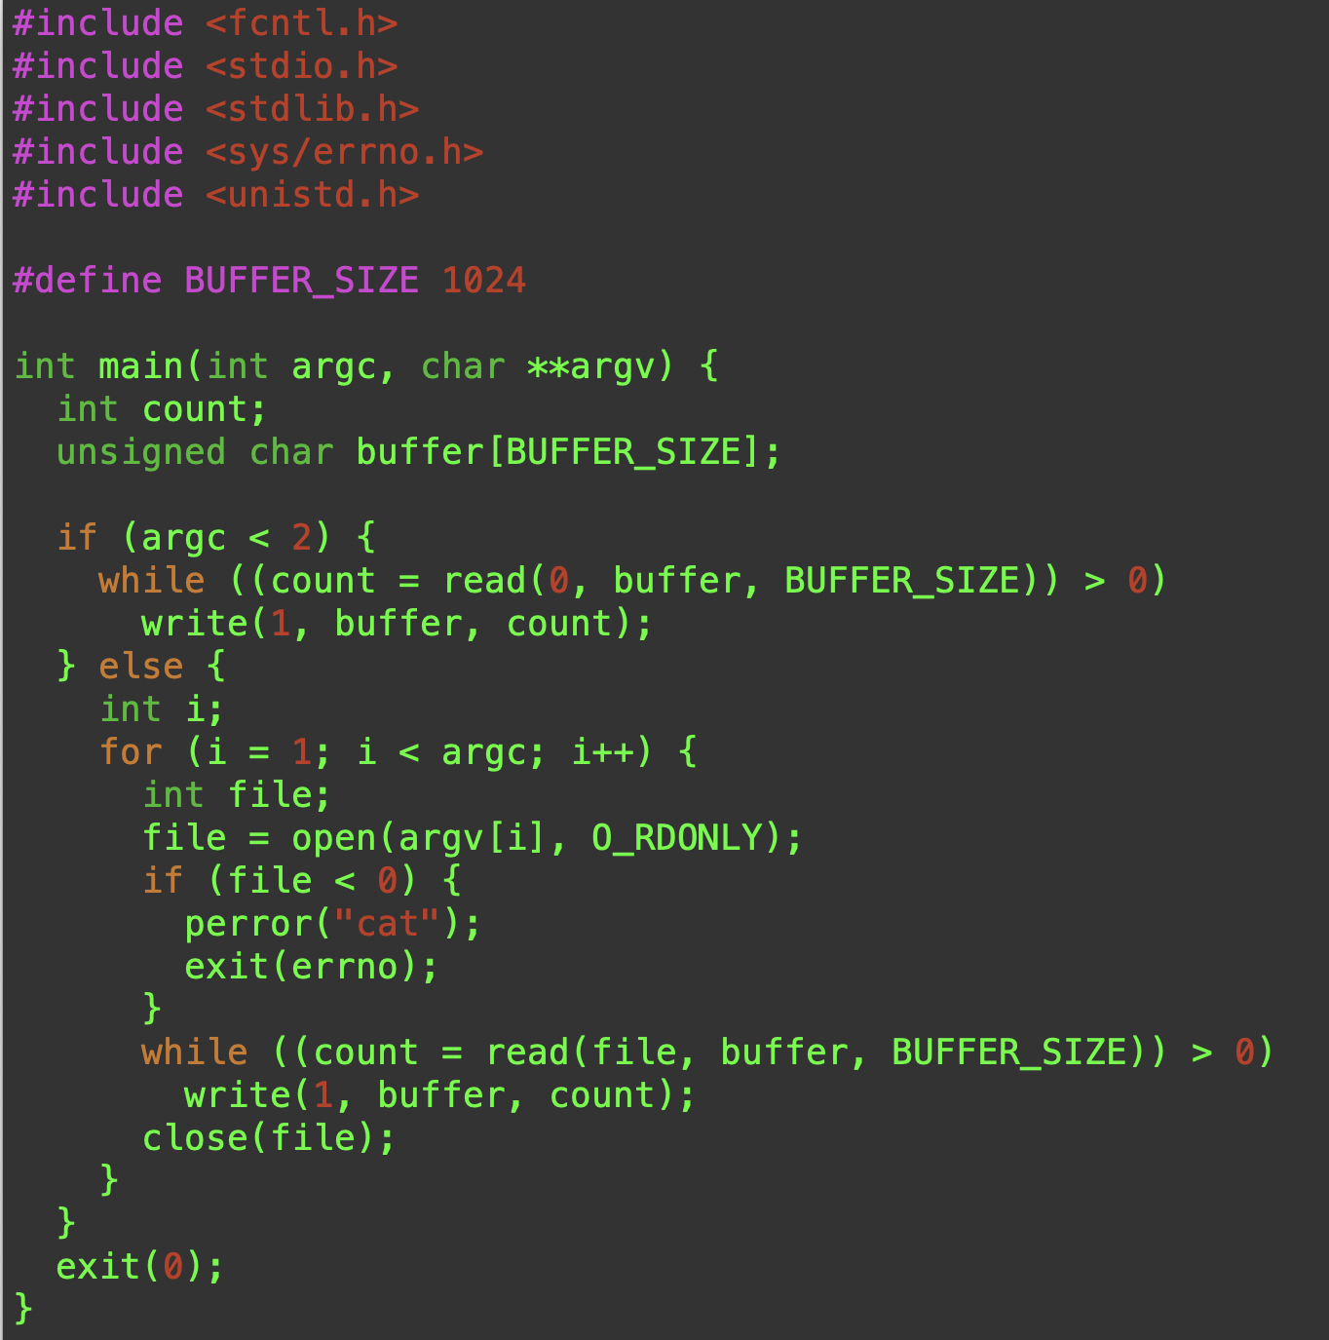
cat.c
argc is the number of arguments.
arvg is an arrays of strings that are the arguments.
Works with both stdin and a list of files.

Slide 14
Process Management
pid = fork()
execvp(program, argv)
pid = wait(status)
fork() creates a clone of the process.
exec() is a family of library routines that wrap a system call to replace the clone of the process with a different program.
wait() is a family of system calls that wait for a process to complete.

Slide 15
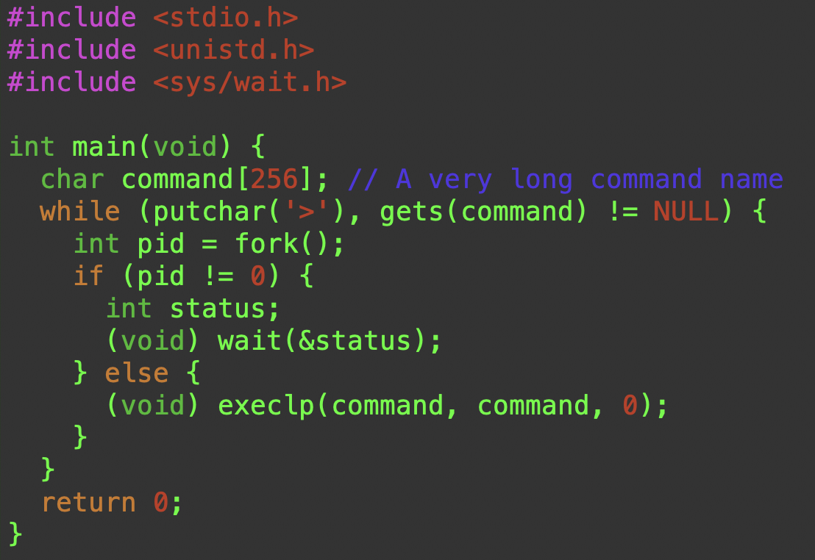
Simplest Shell
This will execute simple commands until you type end-off-file (cntl-D).
This is extremely unsafe code!
Why?

